Slide 1
Overview of Lane Management System CSE 435: Software Engineering
Michigan State University Fall 2024
Team members:
Project Manager: Sawyer VanDyke
Artifacts Manager: Ryon Baldwin-Williams
Facilitator: Grant Bossio & Collin Heavner
Customer Liaison: Ben Grycza
Security/Assurance Manager: Troy Williams
Customer: Mr. Ayush Agrawal
Instructor: Dr. Betty H.C. Cheng*
*Please direct all inquiries to the instructor.
Notes:
‹#›

Slide 2
Project Overview
The Lane Management System will detect lane markings, provide warnings, and apply corrective steering to the vehicle
Motivation for project
Accidents are happening more frequently due to distracted driving
Make the driver aware of their lane, as well as providing assistance to steering
Notes:
‹#›

Slide 3
Overview of Features
Lane Keeping
This feature will keep the car in its own lane, providing a maximum of 2 Nm of force to the steering wheel
Warning features
There are 3 warning features: audible, visual, and steering wheel vibration
Sensors
Cameras for lane detection, GPS for precise lane coordinates, and steering wheel sensor for adjustment
Notes:
‹#›

Slide 4
Domain Research
Investigated existing lane management systems and specifications
Applied domain knowledge when creating LMS specifications
Project Constraints
LMS must only function at 35 mph+
LMS must only function if there are visible lane markings
LMS requires a functioning set of cameras
Notes:
‹#›

Slide 5
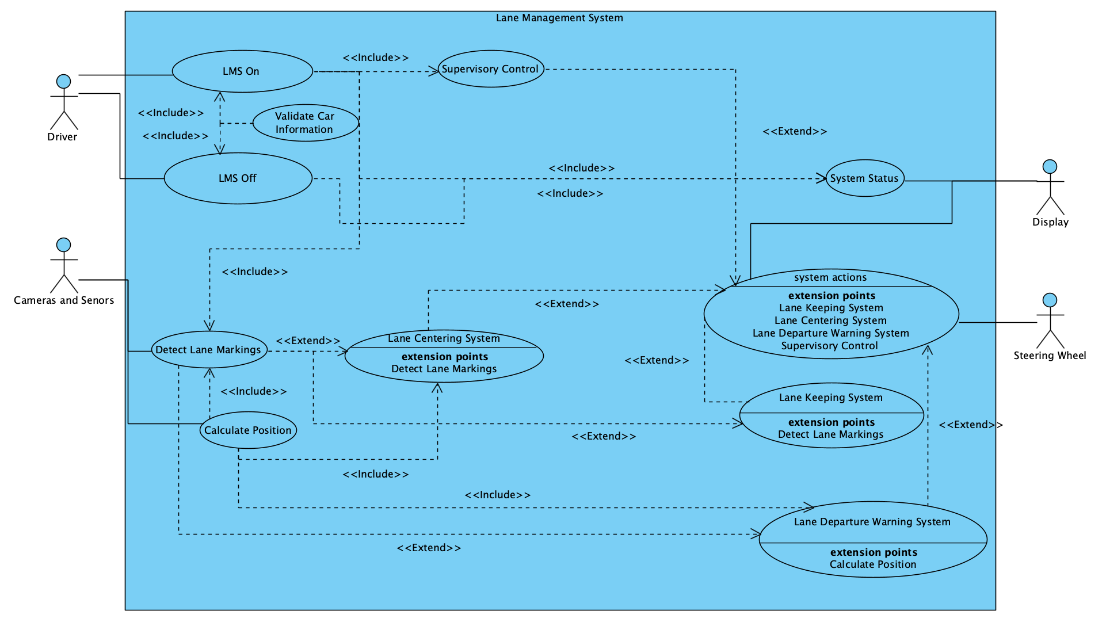
Part II: Model-based View of System
Use Case Diagram
Notes:
‹#›

Slide 6
Key Use Cases
LMS On
Display System Status
Detect Lane Markings
LMS Off
System Actions
Notes:
‹#›

Slide 7
Part III: Demonstration
The prototype is accessed online and uses Unity WebGL Player
Interface:
LMS On and Off indicator
Active Status indicator
Controls:
Movement - Arrow Keys
Toggle LMS - Space Bar

Slide 8
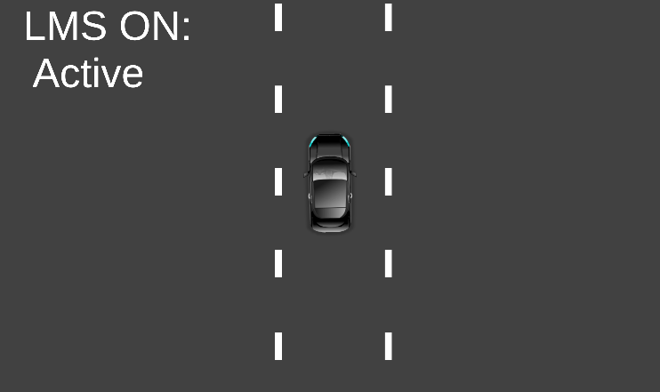
The Ideal Scenario
Uniform and straight road
LMS On
Lanes detected
LMS Active

Slide 9
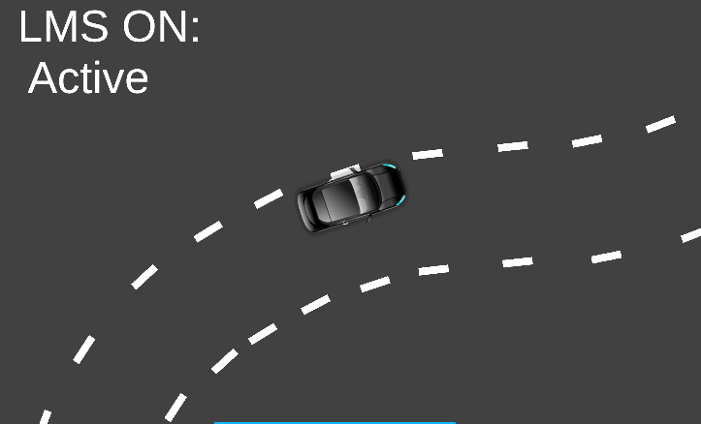
Road Curvature Scenario
Curving and nonuniform lanes
LMS On
Lanes Detected
LMS Active

Slide 10
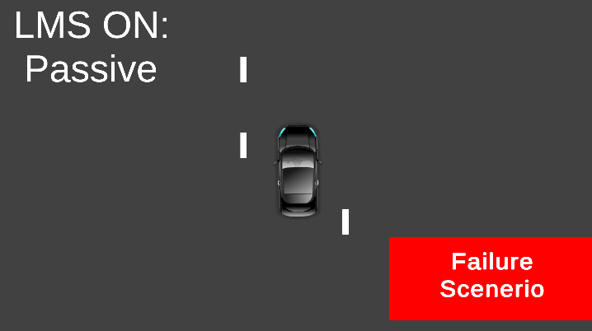
Failure Scenario
Undetectable or unclear lanes
LMS On
Lanes not detected
LMS Passive

Slide 11
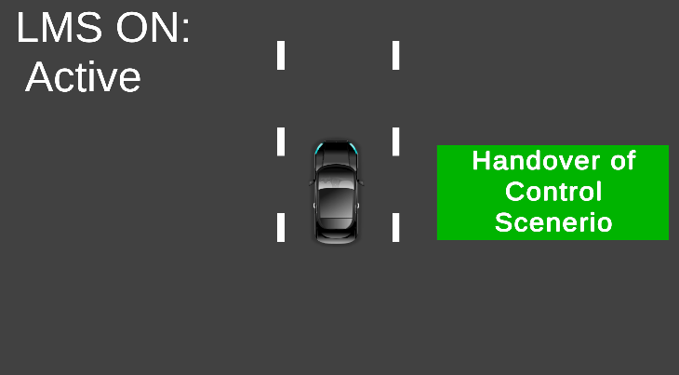
Change of Control Scenario
Lanes detected again after failure
LMS still on
LMS becomes active again on lane detection

Slide 12
Acknowledgements
We gratefully acknowledge and appreciate the participation of our customer, Mr. Ayush Agrawal from Amazon.

